Slide 1
The Future of Storytelling
Jesse Schell
GDC 2013

Slide 2
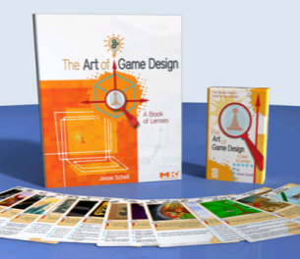

Slide 4
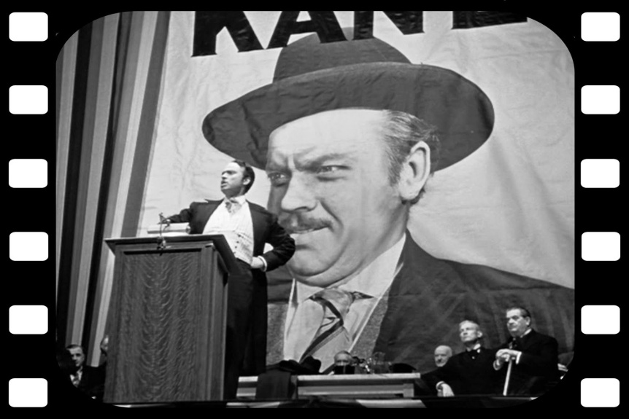
?

Slide 5
Movie Verbs: talk, ask, negotiate, convince, argue, shout, plead, complain
Videogame Verbs: run, shoot, jump, climb, throw, cast, punch, fly

Slide 7
Unity

Slide 10
The Elemental Tetrad
Aesthetics
Mechanics
Story
?
Technology
?

Slide 11
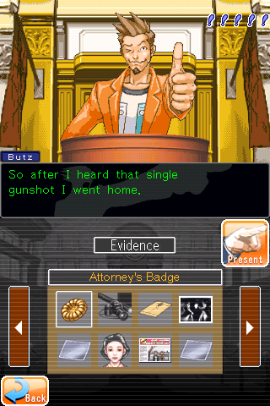

Slide 12
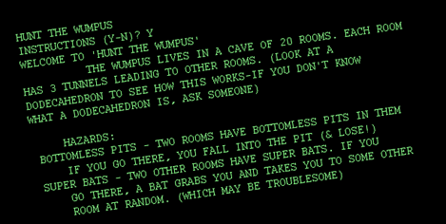
1972
1974

Slide 13
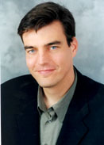
The Prophecy of Chris Swain

Slide 14
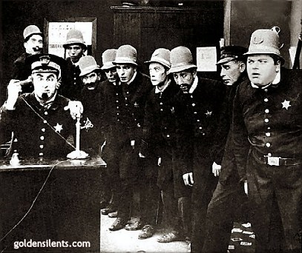
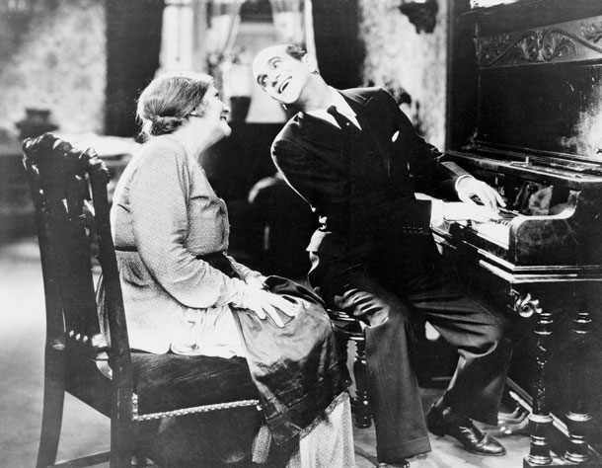
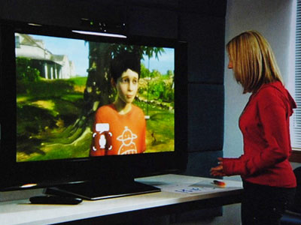
?

Slide 15
Sensing Emotion

Slide 17
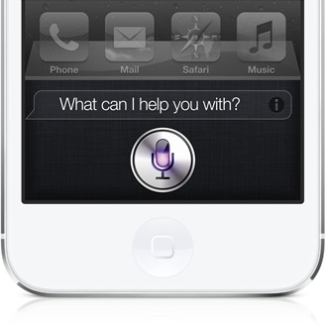

Slide 18
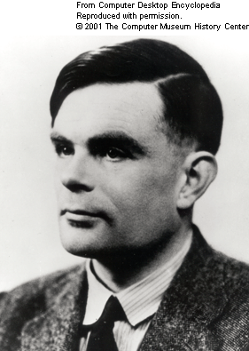
Natural Language Understanding
Eliza: Please tell me what's been bothering you. you: I'm bored. Eliza: Do you enjoy being bored? you: No. Eliza: Does this make you feel unhappy? you: Yes. Eliza: Please go on. you: I want something to do. Eliza: Suppose you got something to do soon. you: That would be great! Eliza: Tell me more about that. you: I'm bored. Eliza: Is it because you are bored that you came to me? you: yes. Eliza: I see.

Slide 19
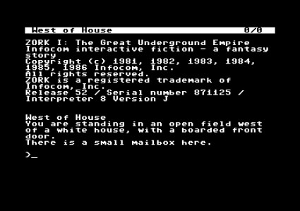

Slide 23
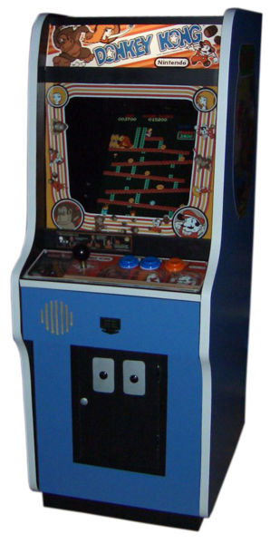

Slide 24
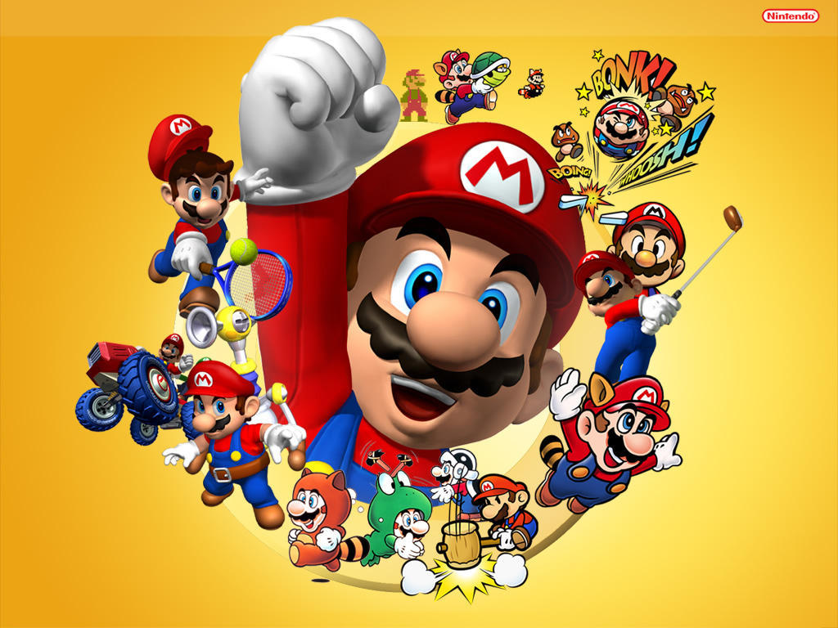

Slide 25
Mass Effect 3

Slide 26
Who will we talk to?
Our avatars.

Slide 27
Who will we talk to?
Our avatars Virtual Companions.

Slide 30
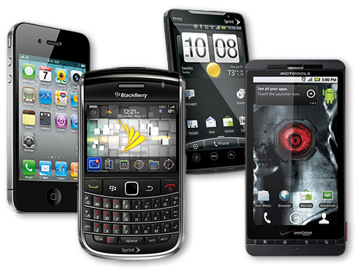

Slide 31
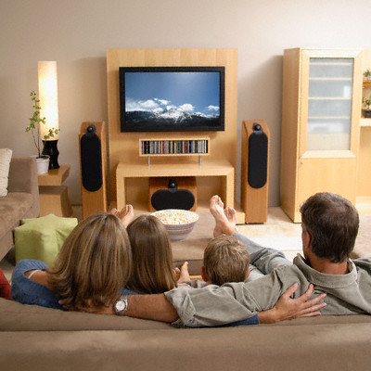
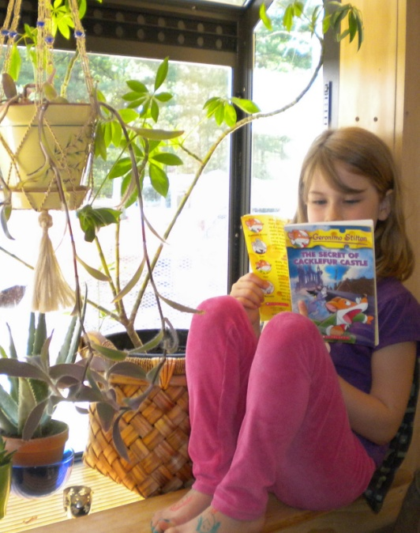
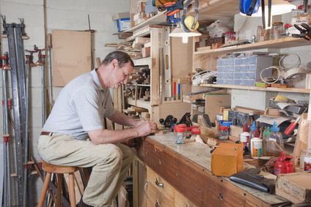
← The Hearth
Reading Nook →
← “Anywhere”
Workbench →

Slide 32
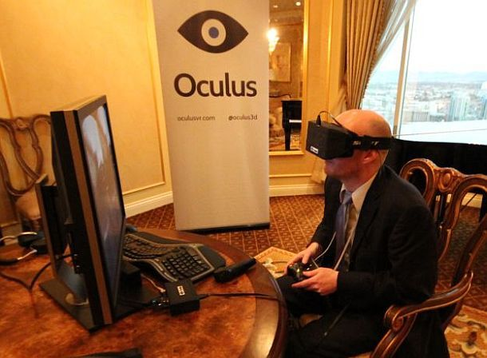

Slide 33
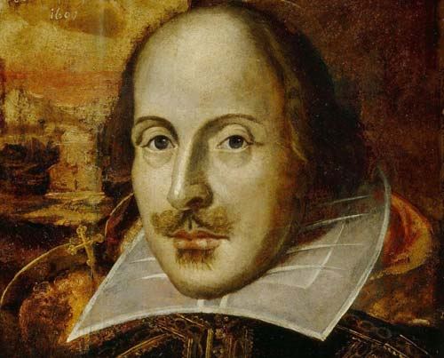

Slide 34
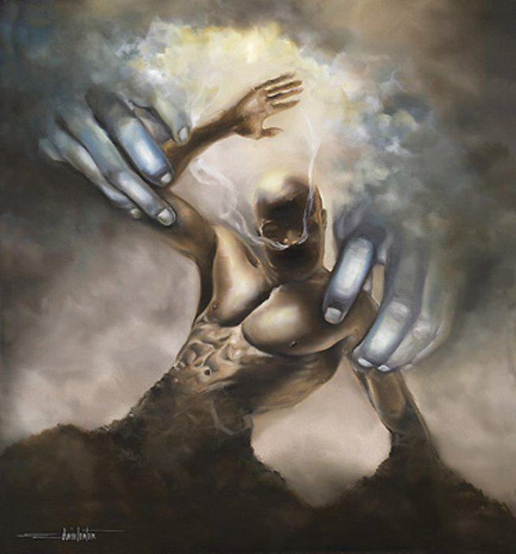

Slide 38
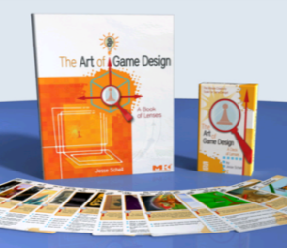
Thanks!
Email: jesse@schellgames.com Slides: jesseschell.com
Twitter: @jesseschell

