Slide 1
FECS'12 - The 2012 International Conference on Frontiers in Education: Computer Science and Computer Engineering, 19july2012, Las Vegas
DUE #0837162
Role of Game Programmers for Serious Games in Academia: Colleague, Collaborator AND Client

Slide 2
The Collaborators at San Diego State University
Kris Stewart, Mark Thompson, Jr., Abhishek Sood, Sathyanarayan Chandrashekar, Megha Shaseendran Computer Science Department, College of Sciences
Mark Siprut School of Art Design and Art History, College of Professional Studies and Fine Arts
Khaled Morsi Mechanical Engineering Department, College of Engineering
Marilee Bresciani Administration, Rehabilitation, and Postsecondary Education Interwork Institute, College of Education;

Slide 3
Discipline Silos at the University
Our Unique Team
Content Specialist material science
Design & Big Picture school of art design
Implementation 3d Maya assets from art provided to XNA game programmers
Assessment text for questions and capturing user responses in database for later analysis
Typical Situation (faculty)
Colleague by assumption
Collaborator when there is a need (can it be mutual?)
Client depends on role definition
Credit convincing your chair and dean of the value to your discipline

Slide 4
This Talk Focusses on the Game Programmer
Instructor is analog, built z80 kit in ‘78 and helped Internet grow up
Typical “silo” traits
Course prerequisites – data structures - ensure real programmers
Course content – 2d game individually 3d game as team
Students are born digital, gamers
New to collaboration outside their field
Teamwork in field is not new (CS 583), teamwork beyond field is challenging (vocabulary and skills)

Slide 5
Project Success
Diverse faculty to maintain focus and “interesting” weekly discussions
Sequence of coders over 3 years all took CS583 for common background
IGDA and ESA current status of game development world (CS583 and after)
MatsISLE Useful example of Serious Games (thanks to Chris Harz who speaks to CS583)

Slide 6
Fig 1: The samples on lab table with Task List for this lab
Standard: each lab starts with Task List

Slide 7
Tensile Test

Slide 8
Fig 2: The Virtual Tensile Testing

Slide 9
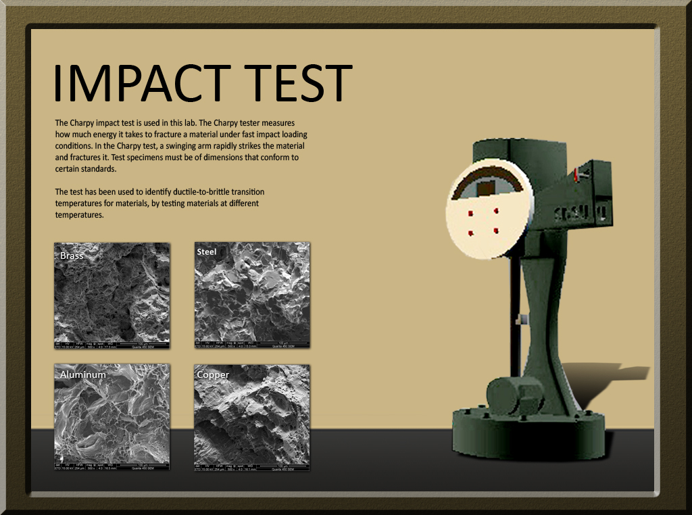
Impact Test

Slide 10
Fig 3: Safety screen to protect users during impact testing

Slide 11
Fig 4: Actual high-speed video of actual Impact Test Machine, included in Materials-ISLE

Slide 12
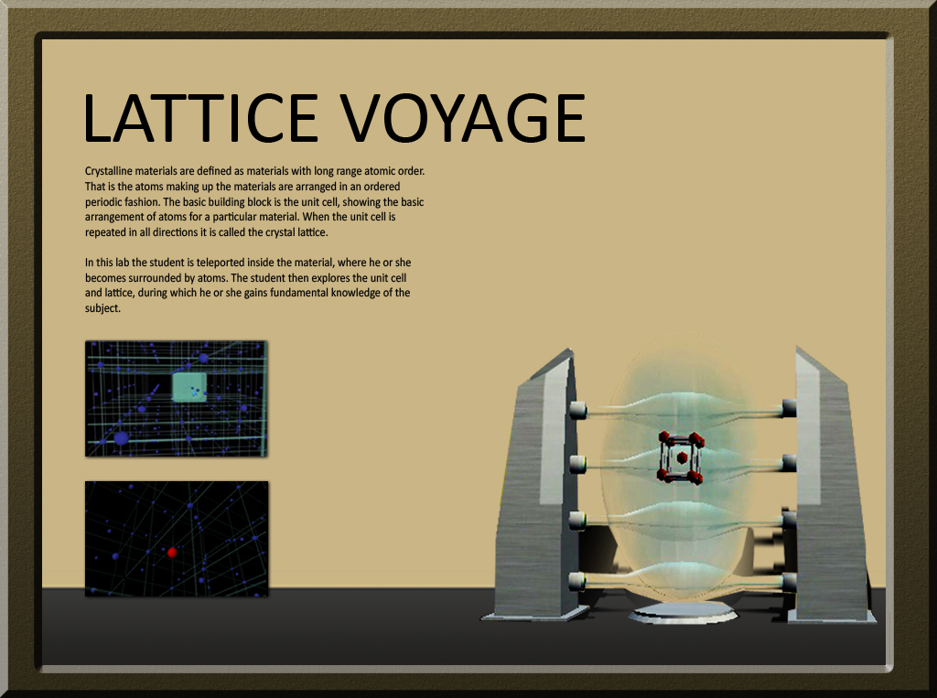
Lattice Voyage - Virtual/Virtual

Slide 13
Figure 5 Virtual Image of teleporter in the virtual lab environment

Slide 14
Fig 6: Student will search the virtual 3D space environment

Slide 15
Quick Demo of Tensile test game
Back up high speed video shown in game

Slide 16
Acknowledgement
Art Design Christina Bertrang, Claudia Faulk, Julius Santos, Jessica Knight and Christine Creber
Assessment Dr. Mark Tucker and Allison Duncan
Mechanical Engineering Kunal Aher, Jimmy Patel and Abinash Numula
NSF Div Undergrad Ed #0837162

Slide 17
References
Microsoft XNA 3.1 and Visual Studio 2008 software, available free to academia for noncommercial development of Windows, Windows Phone and XBOX 360 games http://create.msdn.com/en-US/education/catalog/
Engaging People in CyberInfrastructure (EPIC) NSF Grant to pursue 3d Game Engines as a curriculum tool, Date: 15April2005. NSF OCI # 0520146, subcontract to Boston University and then to SDSU http://www.nsf.gov/awardsearch
Stewart, Kris, 3d Game Programming as Service-Learning for CS Students, J. Comput. Small Coll. 24,4 (April 2009), 246-251.
Harz, Chris, GDC 2009: Serious Games Opportunities, Game Developers Conference Serious Games Summit http://www.awn.com/blogs/animatedtravels/gdc-2009-serious-games-opportunities
Jackson, Melinda, Making visible: Using simulation and game environments across disciplines, contained in Beyond Fun: Serious Game and Media, Davidson, Drew et al, 2008, ETC Press, available as free download http://www.etc.cmu.edu/etcpress/content/beyond-funserious-games-and-media
Exploring the Challenges in Designing and Implementing an Assessment Plan for a Virtual Engineering Materials Lab, Marilee J. Bresciani, Khaled Morsi, Allison Duncan, Mark Tucker, Mark Siprut, Kris Stewart, Eludamos. Journal for Computer Game Culture [EJCGC]. 2010; 4 (2), p. 277-285 http://www.eludamos.org
More in conference paper

